Slide 1
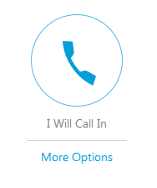
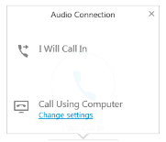
How to Call-in to this Webinar
Select your audio source.
For Computer Audio (Recommended):
Click “Call Using Computer”
If you can’t hear, you may have to click “Change settings”. Select your speaker source.
Telephone Audio:
Click “I will call in”
Dial the number provided.
When prompted, enter the Access Code followed by the # sign.
When prompted, enter Attendee Code followed by the # sign to connect your presence online with your phone
Notes:
Before we get started I would like to go over a few logistical items to help you have the best experience possible today.
We are using WebEx as our webinar platform. You can join the webinar either via telephone or through your computer.
Once you join the webinar, be sure to click the large telephone icon on your screen to make your audio selection.

Slide 2
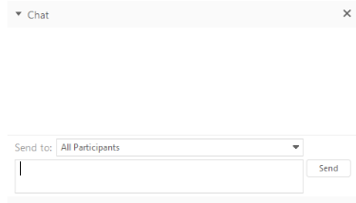
How to Ask Questions or Give Feedback
Q&A: Use the “Q&A” panel to:
Introduce yourself with your name and country
Submit your questions for the speaker and facilitator
Chat: Use the “Chat” panel to:
Communicate problems with the host
Please DO NOT type your questions into the “Chat” panel. Use the “Q&A” panel
For technical issues send chat to “Host”
Notes:
Next, I would like to mention that the WebEx platform has two features that we invite you to use: Q&A and Chat. The buttons for these features are found in the top right hand corner of the WebEx screen. Clicking on these will bring up small panels on the right side of your screen.
Please use the Q&A feature to ask questions. We will take time to answer questions toward the end of the webinar, but we encourage you to submit them as they arise. When submitting a question, please be sure to send it to all panelists and note if there is a specific panelist you would like to answer your question.
You can use the CHAT panel to interact with fellow participants – you will see the “Send To” box where you can select who to send your message to. Please also use the CHAT panel if you experience any technical difficulties, please also use the CHAT panel to send a message to the webinar “host”, whose name is Alena Sims, and she will work to address your issue.
Finally, please note, that this webinar is being recorded. It will be available on the LNCT website for all members.

Slide 3
The Learning Network for Countries in Transition (LNCT)
A platform dedicated to supporting countries as they transition away from Gavi support to full domestic financing of their national immunization programs.
LNCT, pronounced “linked”
15 member countries from various regions, in various stages of the Gavi transition process
Audience is country practitioners and policymakers involved in financing and managing immunization programs in Gavi transitioning countries

Slide 4
Vaccine Prices for Countries after Gavi Transition
LNCT Procurement Webinar Series (3 of 3)
17 July 2018
Juliette Puret, Senior Programme Manager, Immunization Financing and Sustainability, Gavi
Miloud Kaddar, Senior Health Economist, Independent Consultant, LNCT Technical Facilitator
Market shaping and Immunisation Financing & Sustainability Gavi teams

Slide 5
Introduction

Slide 6
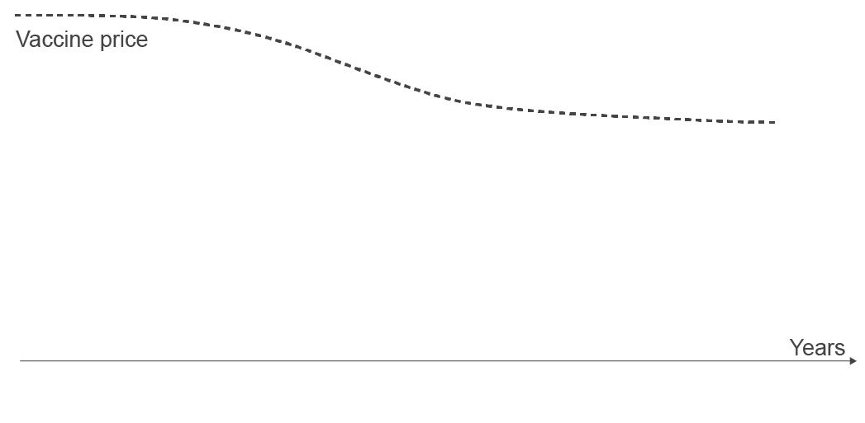
The eligibility, transition and co-financing policies are at the heart of Gavi’s catalytic funding model
WB Low-Income country threshold $1,005 GNI pc
Country co-financing level
Eligibility threshold:
$1,580 GNI pc
Country ownership of Gavi-supported vaccines through a small co-payment while building procurement capacity
Increasing co-payment to prepare for transition (15% per year)
Governments independently financing vaccines
Transition to full financing in 5 years
In 2018: 16 countries in fully self-financing phase.
Which price are they going to pay for initially Gavi- supported vaccines?
6 | www.lnct.global
Notes:
Gavi funding model: country vaccine co-financing increases as economies grow

Slide 7
Gavi’s “Access To Affordable Prices” (ATAP) serves as a bridge towards healthier markets
Gavi countries | Non Gavi LMICs | Non Gavi UMICs | Non Gavi HICs
7 | www.lnct.global

Slide 8
Today webinar’s aim: to clarify the access to prices similar to those paid by Gavi after transition
Objectives:
Share information with Gavi countries in transition about vaccines prices once they are fully self-financing:
What is Gavi market shaping role?
What are the Manufacturers’ price commitments and their eligibility criteria?
How can countries get more information about it?
What does exist to build capacity in vaccine procurement and price?
8 | www.lnct.global

Slide 9
What is Gavi’s market shaping strategic goal?

Slide 10
Gavi Alliance’s long-term vision is to reach healthy vaccine markets for all antigens
Unhealthy vaccine market
Healthy vaccine market
Limited supply
Unpredictable demand
High prices, inappropriate products
Inadequate access to life-saving vaccines
Sufficient supply
Healthy competition
Low and sustainable prices
Appropriate products
So that the right vaccine reaching communities
10 | www.lnct.global
Notes:
SG4.4 target is 6/11 markets with a moderate to high market health.
3 markets with moderate health in 2017, up from two in 2016.
Pentavalent
Yellow Fever: moved from low to moderate health in 2017 reflecting the improved supply situation.
PCV: moved from low to moderate health in 2017 reflecting the availability of an improved multi-dose presentation, that supply meets demand and country preference, and that risk factors are low.
Despite progress being made for a few markets in easing the market failures (notably supply constraints), 8 markets continue to face significant challenges both on supply and demand sides and are assessed with low market health. For these markets, allowing market forces to act alone is likely to be insufficient to achieve Gavi’s market shaping goals and thus active market shaping interventions and careful monitoring of risks need to continue.

Slide 11
What are the manufacturers’ price commitments?

Slide 12
The value of the price commitments
Consider, what will your rent be in 10 years?
Is it possible to know?
NO!
Unique situation for Gavi transitioned countries :
There is no price commitments that ‘guarantee’ prices over time in any industry (with maybe exception of long-term legally binding contracts as seen in the army or aviation industry’s 20 year contracts).
There is no price commitments for any other health commodities.
Valuable for Gavi transitioned countries:
The “manufacturer price commitments” are valuable as they at least provide clarity to help transitioning countries planning and estimating future vaccine budgets.
A counterfactual would be that we have nothing!
12 | www.lnct.global

Slide 13
Pricing commitments are direct commitments between manufacturers and countries
Manufacturer pricing commitments are ‘public announcements’ made during the last Gavi replenishment. They are not legally binding.
Although the Gavi Alliance facilitated the creation and operationalisation of these commitments, Gavi was not involved in defining their conditions.
These commitments are from manufacturers to countries and cannot be guaranteed by Gavi; ultimately the decision lies with individual manufacturers.
These commitments are pledges from manufacturers - they do not create any obligation or engagement for countries.
This information is meant for the convenience and benefit of countries and should not give a false sense of assurance that Gavi is “guaranteeing” prices, and that prices are determined for every single product and country.
13 | www.lnct.global

Slide 14
Overview of manufacturer price commitments for fully self-financing Gavi countries
Vaccine | Manufacturer | Commitment Duration | Commitment characteristics | Max Price info⁴
Rota-virus | GSK | 10 years¹ | Country introduced with Gavi support³ Country already using GSK product Procurement through UNICEF/PAHO | Price freeze
 | Merck | Till end of 2025 | Country GNI per capita ≤ US$ 3,200 in 2013 Procurement through UNICEF/PAHO | Fixed price (US$ 3.5 per dose)
Human Papillo-mavirus | GSK | 10 years¹ | Country introduced with Gavi support Country already using GSK product Procurement through UNICEF/PAHO | Price freeze
 | Merck | Till end of 2025 | Country GNI per capita ≤ US$ 3,200 in 2013 Procurement through UNICEF/PAHO | Fixed price (US$ 4.5 per dose)
Pneumo-coccal | GSK | 10 years¹ | Country introduced with Gavi support Country already using GSK product Procurement through UNICEF/PAHO | Price freeze
 | Pfizer | Till end of 2025 | Procurement through UNICEF | Fixed price US$: 3.30 (1-dose pres°) 3.05 (4-dose pres°)
Pentava-lent | Biological E | Till end of 2019² | Country introduced with Gavi support Procurement through UNICEF | Price freeze
 | Panacea | 5 years¹ | Country introduced with Gavi support Procurement through UNICEF/PAHO | Price freeze
1. From date of transition to fully self-financing, when the country receives no Gavi support anymore
2. Commitment valid for 5 years from 1 January 2015, till end of year 5 or 2019, whichever is earlier
3. Gavi support = when vaccines are co-financed by the country and by Gavi for most of manufacturers
4. Price freeze or fixed price are per specific presentation of the manufacturer vaccine: for instance, a price freeze can be that the price paid the last year of transition is maintained after transition.
14 | www.lnct.global

Slide 15
Overview of manufacturer price commitments for fully self-financing Gavi countries
Vaccine | Manufacturer | Commitment Duration | Commitment characteristics | Max Price info⁴
Rota-virus | GSK | 10 years¹ | Country introduced with Gavi support³ Country already using GSK product Procurement through UNICEF/PAHO | Price freeze
 | Merck | Till end of 2025 | Country GNI per capita ≤ US$ 3,200 in 2013 Procurement through UNICEF/PAHO | Fixed price (US$ 3.5 per dose)
1. From date of transition to fully self-financing, when the country receives no Gavi support anymore
2. Commitment valid for 5 years from 1 January 2015, till end of year 5 or 2019, whichever is earlier
3. Gavi support = when vaccines are co-financed by the country and by Gavi for most of manufacturers
4. Price freeze or fixed price are per specific presentation of the manufacturer vaccine: for instance, a price freeze can be that the price paid the last year of transition is maintained after transition.
15 | www.lnct.global

Slide 16
Overview of manufacturer price commitments for fully self-financing Gavi countries
Vaccine | Manufacturer | Commitment Duration | Commitment characteristics | Max Price info⁴
Rota-virus | GSK | 10 years¹ | Country introduced with Gavi support³ Country already using GSK product Procurement through UNICEF/PAHO | Price freeze
 | Merck | Till end of 2025 | Country GNI per capita ≤ US$ 3,200 in 2013 Procurement through UNICEF/PAHO | Fixed price (US$ 3.5 per dose)
Human Papillo-mavirus | GSK | 10 years¹ | Country introduced with Gavi support Country already using GSK product Procurement through UNICEF/PAHO | Price freeze
 | Merck | Till end of 2025 | Country GNI per capita ≤ US$ 3,200 in 2013 Procurement through UNICEF/PAHO | Fixed price (US$ 4.5 per dose)
Pneumo-coccal | GSK | 10 years¹ | Country introduced with Gavi support Country already using GSK product Procurement through UNICEF/PAHO | Price freeze
 | Pfizer | Till end of 2025 | Procurement through UNICEF | Fixed price US$: 3.30 (1-dose pres°) 3.05 (4-dose pres°)
Pentava-lent | Biological E | Till end of 2019² | Country introduced with Gavi support Procurement through UNICEF | Price freeze
 | Panacea | 5 years¹ | Country introduced with Gavi support Procurement through UNICEF/PAHO | Price freeze
1. From date of transition to fully self-financing, when the country receives no Gavi support anymore
2. Commitment valid for 5 years from 1 January 2015, till end of year 5 or 2019, whichever is earlier
3. Gavi support = when vaccines are co-financed by the country and by Gavi for most of manufacturers
4. Price freeze or fixed price are per specific presentation of the manufacturer vaccine: for instance, a price freeze can be that the price paid the last year of transition is maintained after transition.
16 | www.lnct.global

Slide 17
Overview of manufacturer price commitments for fully self-financing Gavi countries
Vaccine | Manufacturer | Commitment Duration | Commitment characteristics | Max Price info⁴
Rota-virus | GSK | 10 years¹ | Country introduced with Gavi support³ Country already using GSK product Procurement through UNICEF/PAHO | Price freeze
 | Merck | Till end of 2025 | Country GNI per capita ≤ US$ 3,200 in 2013 Procurement through UNICEF/PAHO | Fixed price (US$ 3.5 per dose)
Human Papillo-mavirus | GSK | 10 years¹ | Country introduced with Gavi support Country already using GSK product Procurement through UNICEF/PAHO | Price freeze
 | Merck | Till end of 2025 | Country GNI per capita ≤ US$ 3,200 in 2013 Procurement through UNICEF/PAHO | Fixed price (US$ 4.5 per dose)
Pneumo-coccal | GSK | 10 years¹ | Country introduced with Gavi support Country already using GSK product Procurement through UNICEF/PAHO | Price freeze
 | Pfizer | Till end of 2025 | Procurement through UNICEF | Fixed price US$: 3.30 (1-dose pres°) 3.05 (4-dose pres°)
Pentava-lent | Biological E | Till end of 2019² | Country introduced with Gavi support Procurement through UNICEF | Price freeze
 | Panacea | 5 years¹ | Country introduced with Gavi support Procurement through UNICEF/PAHO | Price freeze
1. From date of transition to fully self-financing, when the country receives no Gavi support anymore
2. Commitment valid for 5 years from 1 January 2015, till end of year 5 or 2019, whichever is earlier
3. Gavi support = when vaccines are co-financed by the country and by Gavi for most of manufacturers
4. Price freeze or fixed price are per specific presentation of the manufacturer vaccine: for instance, a price freeze can be that the price paid the last year of transition is maintained after transition.
17 | www.lnct.global

Slide 18
Current UNICEF pentavalent tender award prices apply to all countries, regardless their Gavi eligibility status
Manufacturers have made commitments for Gavi-transitioning countries for pentavalent vaccines.
However, as of 2017, all UNICEF suppliers of pentavalent vaccine are offering the same price to all countries buying through UNICEF, irrespective of their Gavi support eligibility status.
Information on pentavalent prices is available from UNICEF at: https://www.unicef.org/supply/files/DTP-HepB-Hib.pdf
18 | www.lnct.global

Slide 19
Key aspects to note on manufacturer price commitments for Gavi fully self-financing countries
Procurement through UNICEF/PAHO is mandatory, unless otherwise specified.
New presentations of the same vaccines or new vaccines will be evaluated for inclusion in the commitment as they become available.
Commitments were not negotiated by Gavi, they were offered by manufacturers. There is no process for renewal or extension of current commitment terms. If manufacturers approach Gavi regarding renewal or extension, the information will be communicated appropriately.
More details can be found in the manufacturer price commitment FAQs in summary PDF on Gavi’s website: http://www.gavi.org/library/gavidocuments/supply-procurement/vaccine-price-commitments-from-manufacturers/
19 | www.lnct.global

Slide 20
How can countries get more information on their eligibility to these commitments?

Slide 21
Proposed way of communication: who to contact from which partner
For additional information regarding the pricing commitments, countries have three possible lines of direct contact
Countries can also contact manufacturers directly**
1
Gavi Senior Country Manager
2
UNICEF Supply Division*
3
* Prior to contacting UNICEF SD, countries should first consult available resources at UNICEF Country Offices. If countries decide to contact UNICEF SD for pricing related questions, UNICEF CO should be copied in the correspondences.
** Manufacturer contact information can be found within the Price Commitment FAQs:
https://www.gavi.org/library/gavi-documents/supply-procurement/
Available on line
Brief overview
of all manufacturers’ commitments
Each commitment is detailed under a “FAQ” document
example

Slide 22
How can countries get more information on vaccine prices?

Slide 23
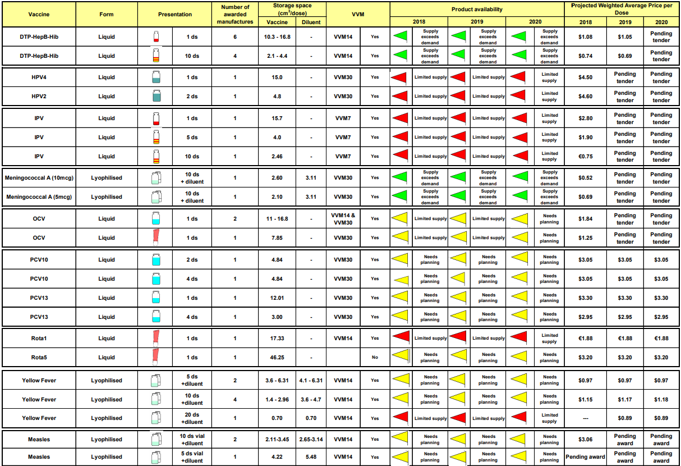
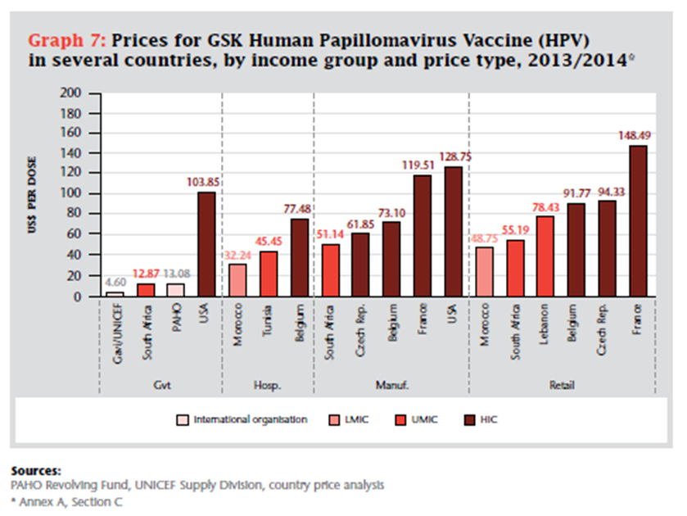
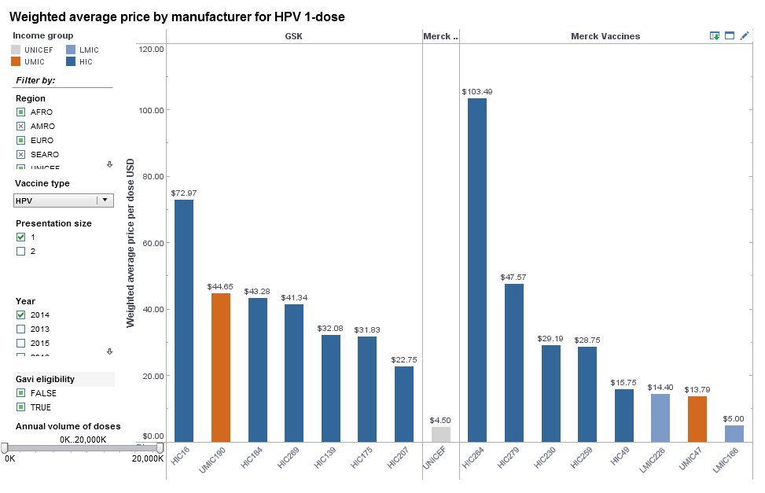
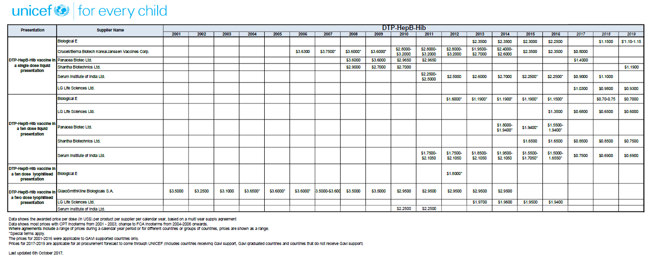
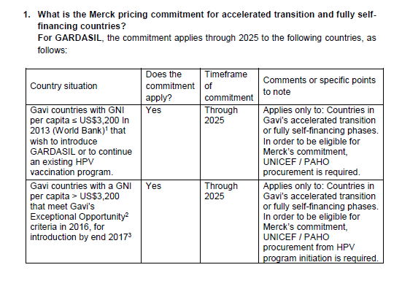
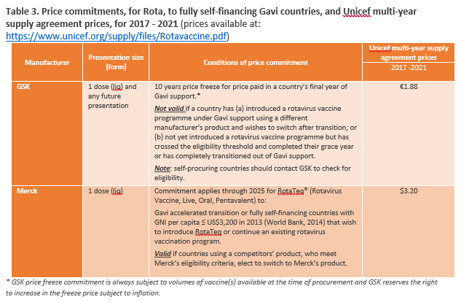
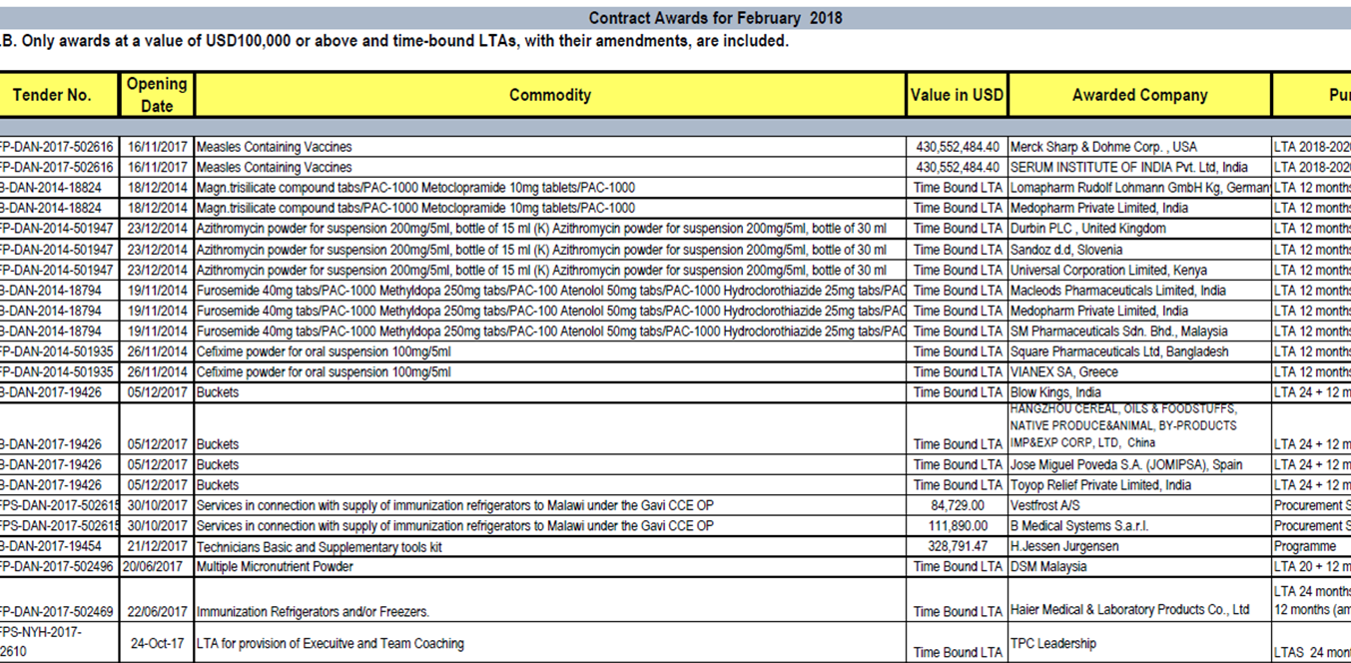
Existing vaccine information tools and publications available for countries
Tools
Publications
Product Menu for Gavi-Supported Vaccines
Detailed Product Profile
V3P/MI4A
The Right Shot 2nd Ed.
Tender Award Prices
Transparency Awards
Fact Sheet on Vaccine Pricing
Manufacturer FAQs
Market Notes
23 | www.lnct.global
Notes:
Can be used for budgeting, planning
Cf other webinars

Slide 24
Several ongoing initiatives to strengthen capacity on vaccine pricing and procurement
Knowledge and understanding of vaccine pricing requires time and capacity building at global, regional and national levels.
Transition and post-transition engagement includes support on vaccine procurement capacity building.
The Gavi Alliance partners have initiated the following (partly funded by Gavi sustainability SFA funding):
LNCT – Learning Network for Countries in Transition
https://lnct.global/ (focus on vaccine procurement in 2018 – webinar on prices and procurement)
Development of a vaccine procurement assessment tool (UNICEF)
Development of 16 Gavi transitioning country fact-sheets on vaccine prices (WHO)
VPPN - Vaccine Procurement Practitioner Network (UNICEF)
http://www.vppnetwork.org/
Development of an e-module on vaccine procurement (UNICEF)
Targeted technical assistance (Partners)
24 | www.lnct.global

Slide 25
Summary and conclusion

Slide 26
Vaccine prices after Gavi transition: key takeaways
Unique situation for vaccines: there are manufacturers’ commitments regarding prices after Gavi transition.
These commitments are from manufacturers to countries and cannot be guaranteed by Gavi.
Every country should look into details whether commitments can apply or not (see slide 15).
Gavi Alliance can help, including UNICEF and WHO, to get more information. Countries can also directly contact manufacturers.
There are several ongoing initiatives to reinforce vaccine procurement knowledge and capacities.
CONTACT INFO @ Gavi :
Juliette Puret, Senior Programme Manager - Immunisation Financing and Sustainability team
Jpuret-external-consultant@gavi.org
Edward Baker, Senior Specialist - Strategy, Development and Tenders, Policy & Market Shaping ebaker@gavi.org
26 | www.lnct.global

Slide 27
QUESTIONS

Slide 28
Q&A Discussion Summary (1 of 2)
How many countries are in the post-transition phase and how many are benefitting from Gavi prices? At the moment, there are 16 countries in post-transition and all of them have mentioned access to a similar price. We cannot say Gavi prices anymore, because by definition it is not Gavi anymore. It can be a little different because all the different commitments and each country has different access. The prices mentioned during this presentation are in general the maximum prices, but it can actually be lower.
Is it possible to switch to another presentation and benefit from Gavi price for a vaccine introduced with Gavi support? It’s a tricky question…it depends on every manufacturer. [The] first thing you should look at is which presentation you have and then see whether it would be worth it to switch to another, not only taking into account the price but also the storage capacity, training, etc. Most manufacturers allow the country to switch [with the exception of] GSK.
Have any Gavi countries adopted the new Rotavirus vaccine? In terms of Gavi countries in post-transition, I don’t think so. For all the Gavi countries, this is in discussion especially regarding the supply issues that can [occur with] the different vaccines in general. This would be facilitated by Gavi.
What is the procedure to access AMC price for PCV if the country has not introduced PCV during its eligibility period? What we have to keep in mind is that AMC is very specific to the PCV market only, which is basically more financing tools that can lower large subsidies of the vaccines. Countries are paying 3.5 dollars less now and Gavi is paying 3.5 dollars, so the manufacturers are getting $7 per dose. Because of the AMC, many countries have been able to introduce the vaccine. The AMC exists only until 2020 for the moment and the process to benefit from it is directly [through] Gavi and UNICEF – a country can just contact UNICEF or Gavi to express interest in the product. Every Gavi country is automatically part of the AMC, but for countries in post-transition, it is something to double-check with the manufacturer.

Slide 29
Q&A Discussion Summary (2 of 2)
You mentioned that one of the conditions is that countries use UNICEF or PAHO. For countries in the post-transition phase, they may have their own regulations on procurement and have to use their self-procurement mechanism. Is it possible for countries to self-procure and benefit from Gavi prices? In general, manufacturers have specified that the procurement has to be through UNICEF or PAHO. That’s because it’s much easier for them to foresee demand and adapt supply. Gavi has not negotiated anything on these commitments and it’s not something we [Gavi] can change, but if a country is self-procuring, they should be able to. It can be discussed with the manufacturer.
What’s the best way for country teams to be informed on the latest developments or changes in the policy and practices related to vaccine prices for countries after transition? The best way is to first check on the Gavi website, which is updated quite often. We do not foresee any changes in these commitments, as there was no process of re-negotiating these commitments in the future. I would encourage these countries to look for the information on the prices that they already pay and the prices they could pay after transition. Also, directly asking their [Gavi] senior country manager.
Are Gavi prices available to countries with similar GNI per capita than Graduated countries? Are there any conditions? There might be some manufacturers that calculate based on the GNI per capita, but it’s more based on the GNI per capita of the past. It’s already a condition because that’s what explains that a country is in post-transition because the Gavi transition policy is that it is based on the GNI per capita. One manufacturer has a condition [where] the GNI per capita in 2013 has to be below 3,200. The idea behind this is if a country has a very small capacity to pay, there’s more chance to be eligible to these commitments.
Is there any monitoring of vaccine prices post-transition? By whom and how? We are still developing, as it’s new to countries in post-transition. For the moment, the monitoring process will be through UNICEF, as they’ve been engaged in the transparency policy of prices that they offer to the countries. If countries enter the data in the V3P tool about the price they are paying, that’s another way to monitor what will be the price after transition. At Gavi, we can probably have access to this information in collaboration with UNICEF.

Slide 30
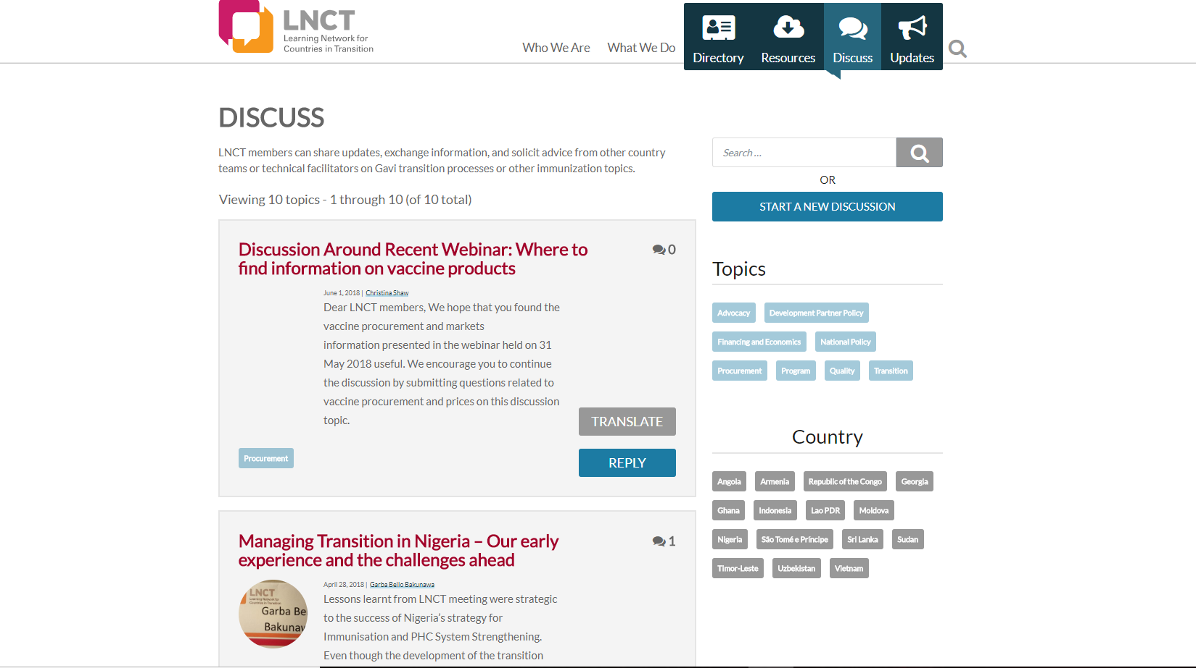
Continue the conversation on the LNCT discussion forum
Explore at: https://lnct.global/forums/forum/discuss/
30 | www.lnct.global

